Slide 1
Comparing Algorithms

Slide 2
Learning Goals
In this section, we will cover:
- A review of clustering approaches
- Summarizing and comparing clustering approaches
- Guidelines for choosing an approach

Slide 3
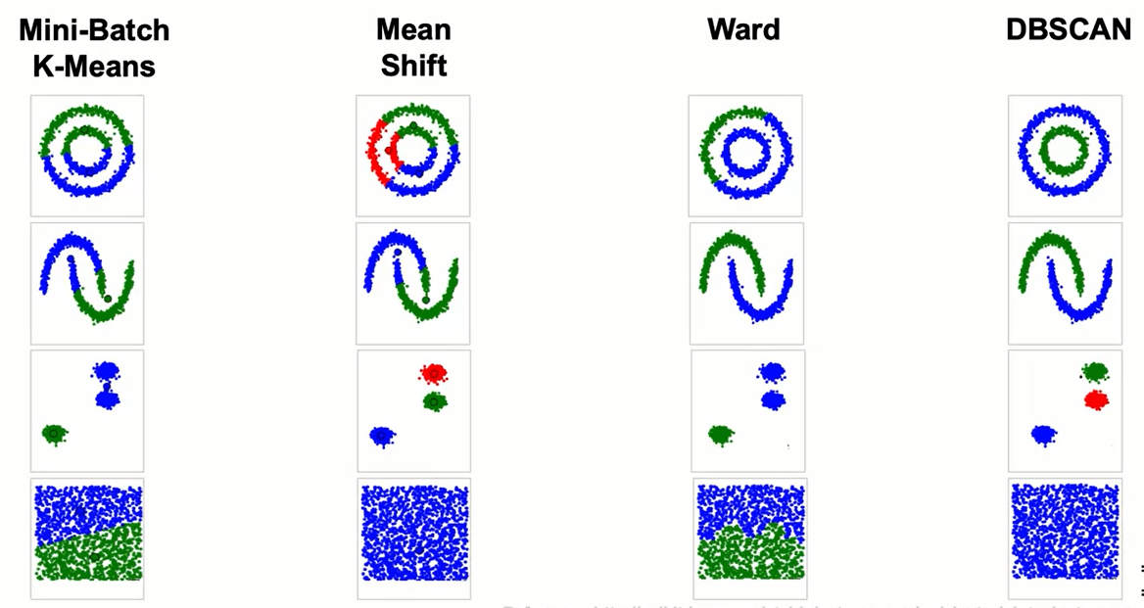
Clustering Approaches: Summary

Slide 4
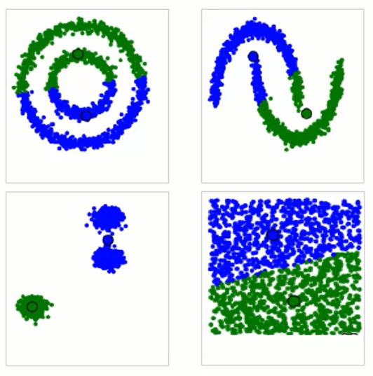
K Means
- MiniBatch version is fast (big data).
- Have to try k values (k not too big).
- Tends to find even sized clusters.
- Bad with non-spherical cluster shapes.

Slide 5
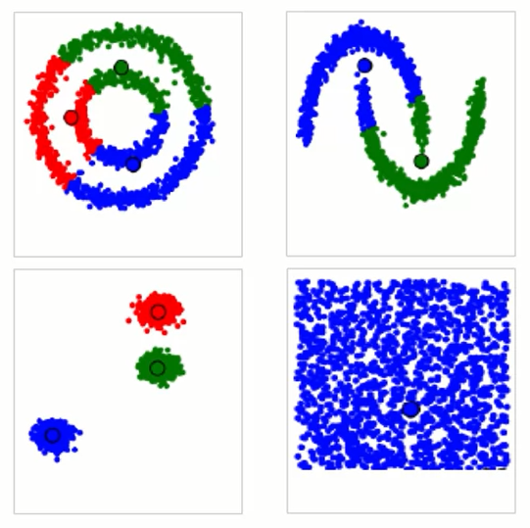
Mean-shift
- DON'T have to guess k.
- Can find uneven cluster sizes.
- Slow with a lot of data
- Lots of clusters? No problem
- Doesn't handle weird shapes well.
- Euclidean distance only.

Slide 6
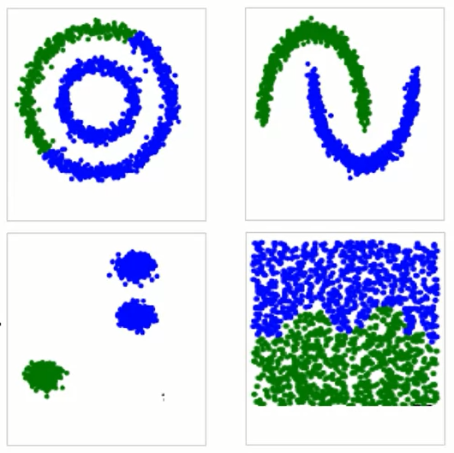
Hierarchical Clustering (Ward)
- Get a full hierarchy tree.
Useful for some problems.
- Have to try k values.
- Finds uneven cluster sizes
(one is big, some are tiny).
- A lot of distance metric and linkage options.
- Can be slow to calculate (complexity proportional to squared number of observations).

Slide 7
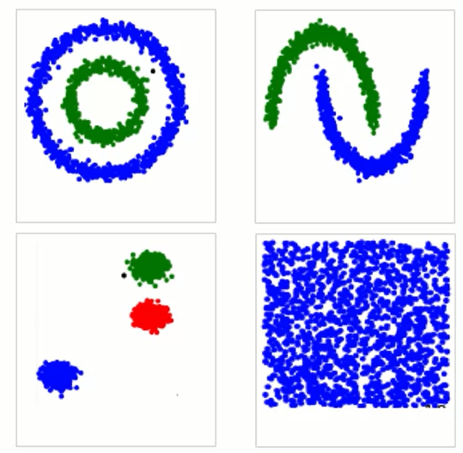
DBSCAN
- Density based, on the money with the right parameters.
- Have to try epsilon (and num_clu) values.
- Can find uneven cluster sizes.
- Full distance metric options.
- Can handle tons of data and weird shapes.
- Too small epsilon (too many clusters) is not trustworthy.
- Does not do well with clusters of different

Slide 8
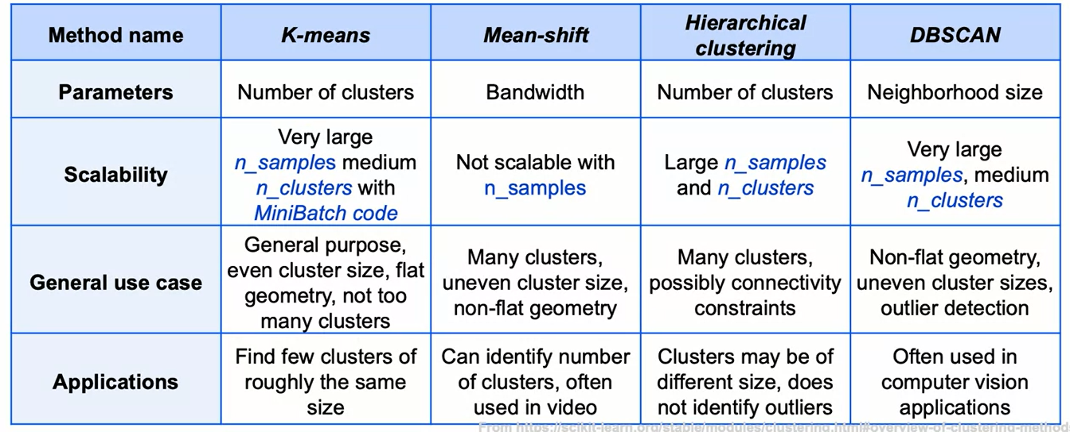
Clustering Approaches: Summary
A summary of approaches to clustering, along with general use cases and applications.

Slide 9
Summary
- Clustering: unsupervised learning technique for grouping data.
- Several approaches possible:
• KMeans
• Hierarchical Agglomerative Clustering
• DBSCAN
• Mean shift
- All implemented in scikit-learn
• https://scikit-learn.org/stable/modules/clustering.html

Slide 10
Learning Recap
In this section, we discussed:
- A review of clustering approaches
- Summarizing and comparing clustering approaches
- Guidelines for choosing an approach

